Slide 1
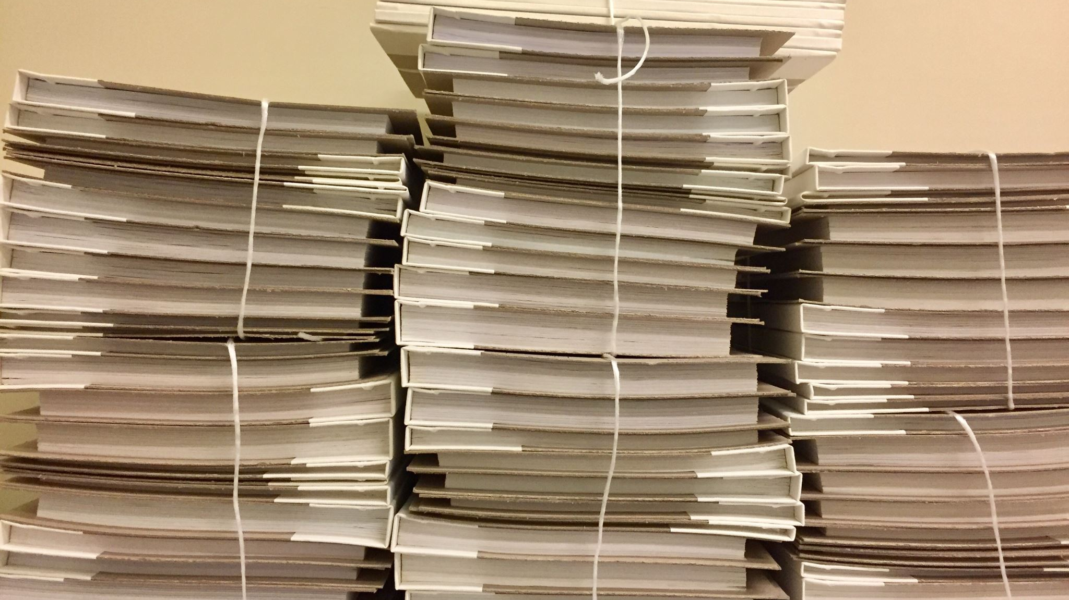
Face Recognition-Based Smart Attendance System

Slide 2
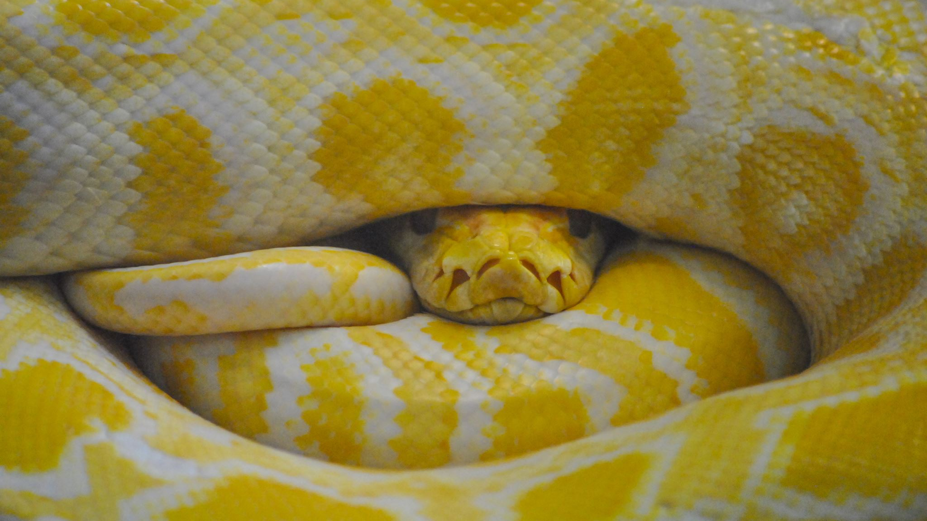
Subtitle: Using Python, ML, and KNN Algorithm

Slide 3
Slide 2: Introduction**
Introduction to the topic
Importance of attendance tracking
Overview of the system

Slide 4
Slide 3: Objectives**
Listing the objectives of the presentation
Highlighting the main goals: Automation, Accuracy, and Efficiency

Slide 5
Slide 4: System Components**
Briefly explain the components of the system
Face Detection Module
Face Recognition Module
KNN Algorithm
CSV Data Storage
Streamlit Interface

Slide 6
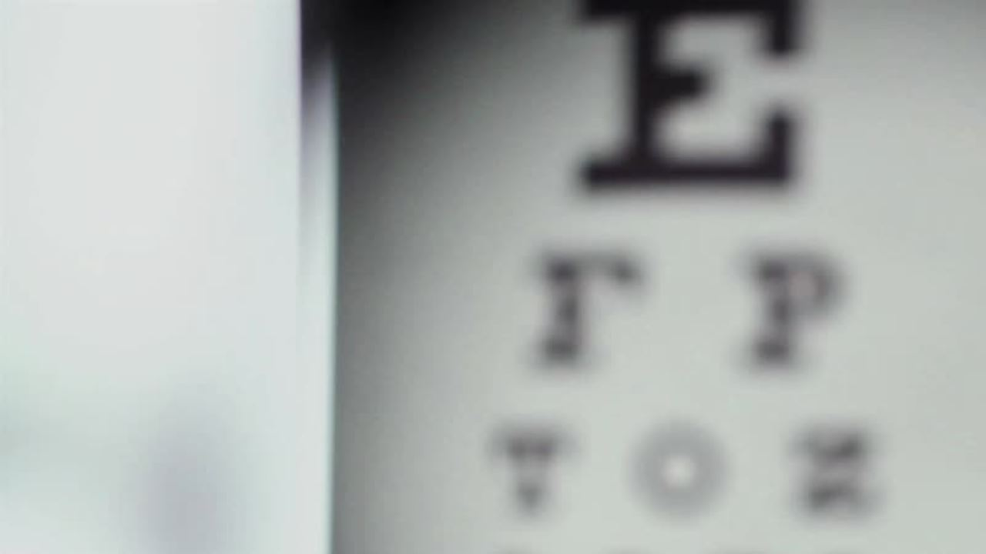
Slide 5: Face Detection**
Explain the face detection process
Use of OpenCV for face detection
Briefly describe Haar Cascade Classifier

Slide 7

Slide 6: Face Recognition**
Explain the face recognition process
How the system identifies individuals
Importance of feature extraction
Detail the KNN algorithm
How it works for face recognition
Mention the importance of choosing the right 'K' value

Slide 8
Slide 8: Data Storage**
- Describe how attendance data is stored in CSV files
- Data structure
- Benefits of CSV for simplicity and compatibility

Slide 9
Slide 9: Streamlit Interface**
- Introduction to Streamlit
- Its role in displaying attendance data
- User-friendly interface for viewing attendance

Slide 10
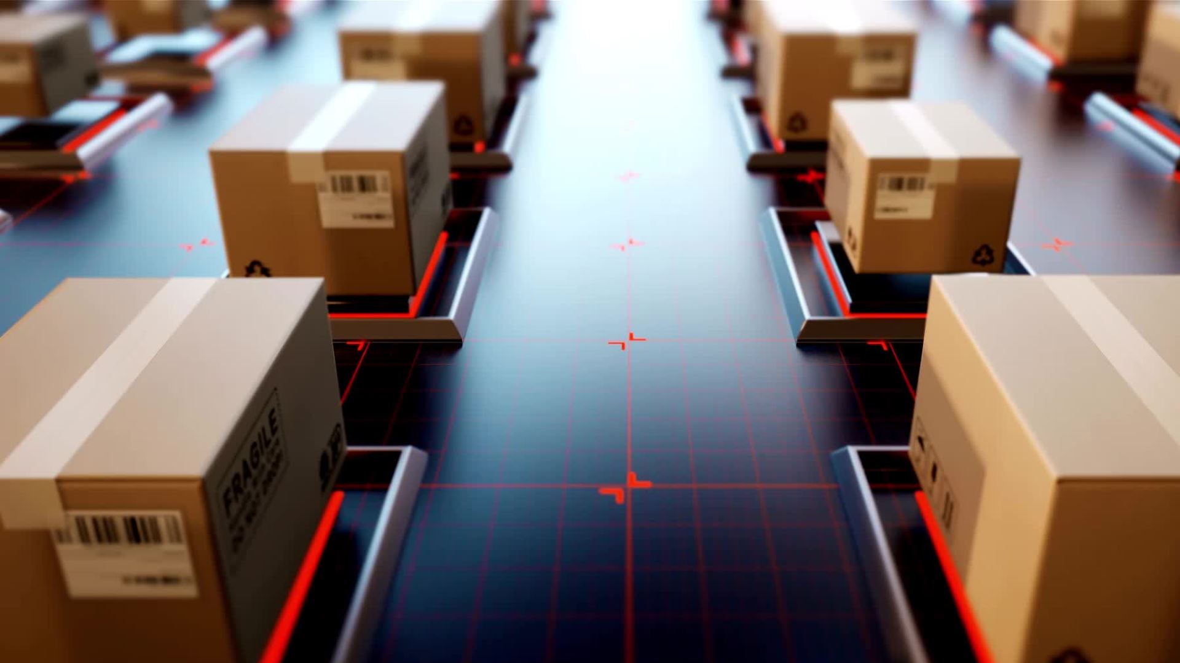
Slide 10: System Workflow**
- Describe the step-by-step workflow of the system

Slide 11
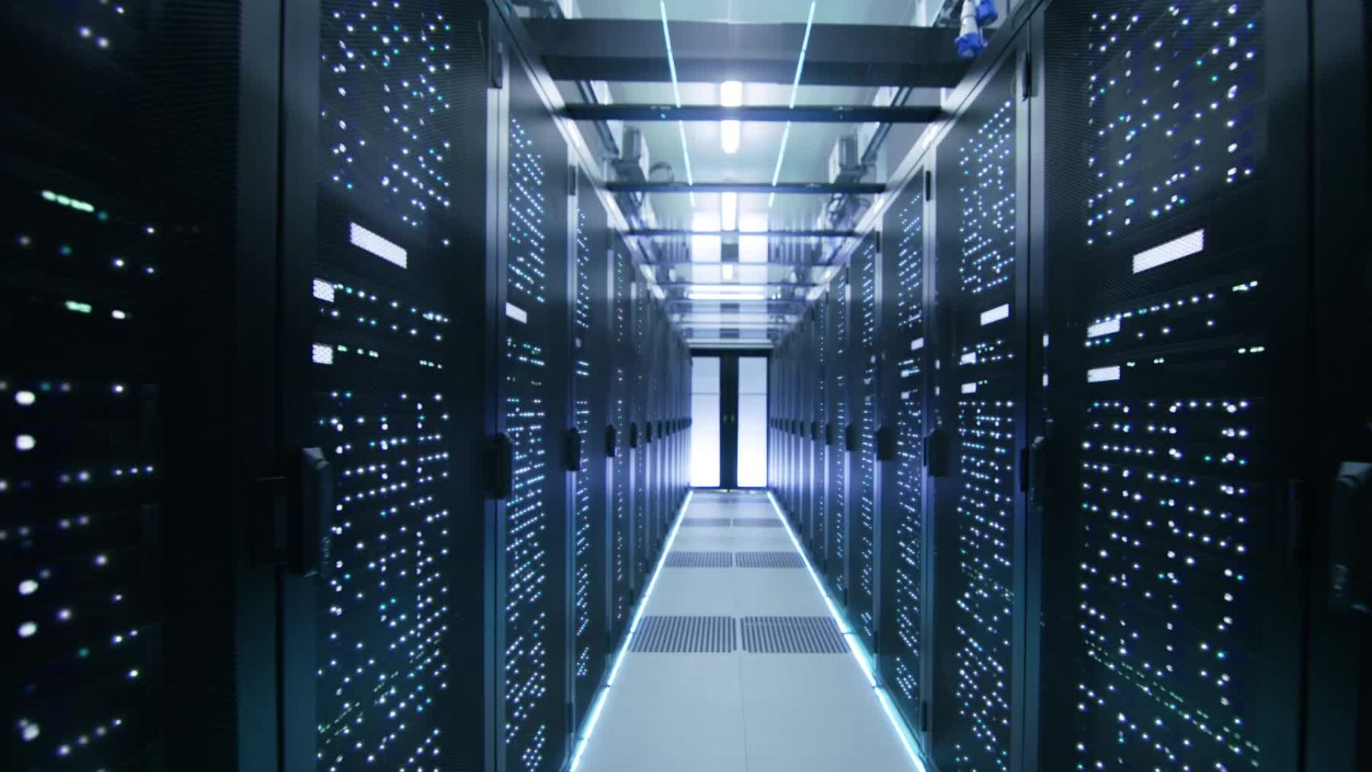
Slide 11: System Implementation**
- Discuss how to implement the system
- Code structure
- Python libraries used
- Training the model

Slide 12
Slide 12: Challenges & Solutions**
- Highlight common challenges and their solutions
- Variability in lighting conditions
- Handling errors and exceptions

Slide 13
Slide 13: Benefits**
- Discuss the benefits of the system
- Improved accuracy in attendance tracking
- Time-saving and efficiency
- Reduced administrative workload

Slide 14
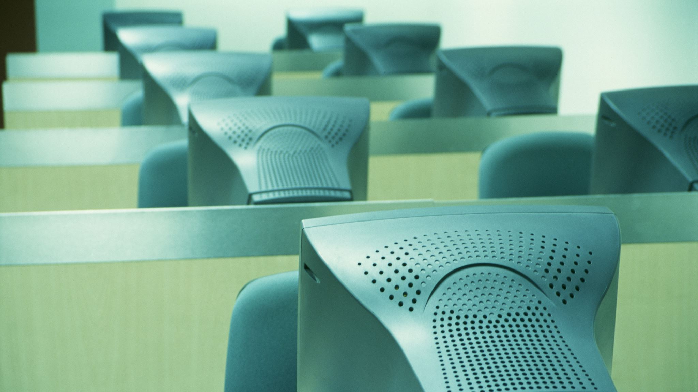
Slide 14: Use Cases**
- Share potential use cases
- Educational institutions
- Corporations
- Any organization requiring attendance tracking

Slide 15
Slide 15: Future Enhancements**
- Discuss possible improvements and future developments
- Integration with biometric systems
- Real-time attendance monitoring

Slide 16
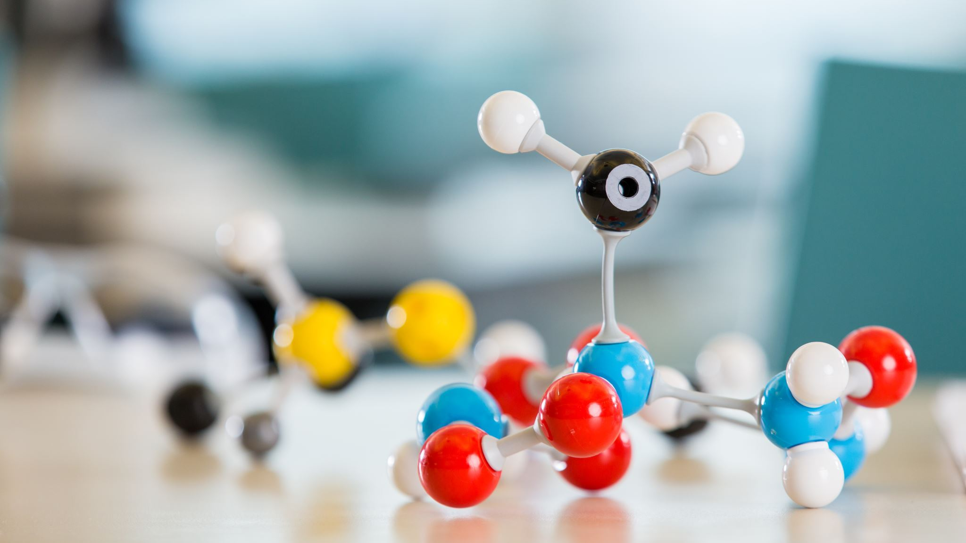
Slide 16: Conclusion**
- Summarize the key points
- Reiterate the importance of the system

Slide 17
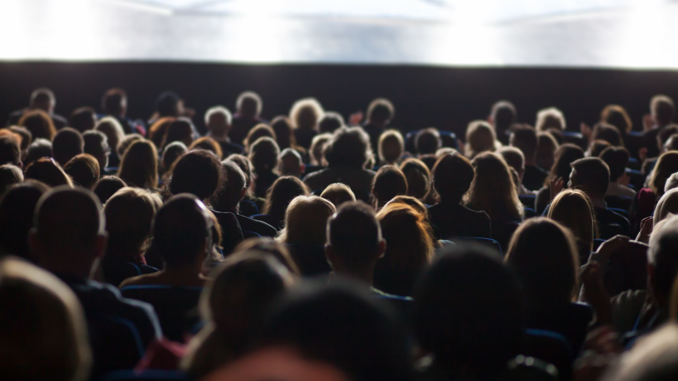
Slide 17: Q&A**
- Invite questions from the audience

Slide 18
Slide 18: Thank You**
- Express gratitude to the audience for their attention
- Provide contact information for further inquiries

Slide 19
Slide 19: References**
- List the sources, libraries, and frameworks used in the project
- Include a live demo or screenshots of the system in action if available

